Slide 1


Neutrals Learning Center

Slide 2
Channel Objective?
Provide a step-by-step Learning Path to become
0 to Professional Java Angular Fullstack Developer.
We will start from absolute scratch.
All Tutorials accompanied with Reference Materials
Tutorials have assessments in Googleclassroom

Slide 3






Levels - 1 Or Primary

Slide 4




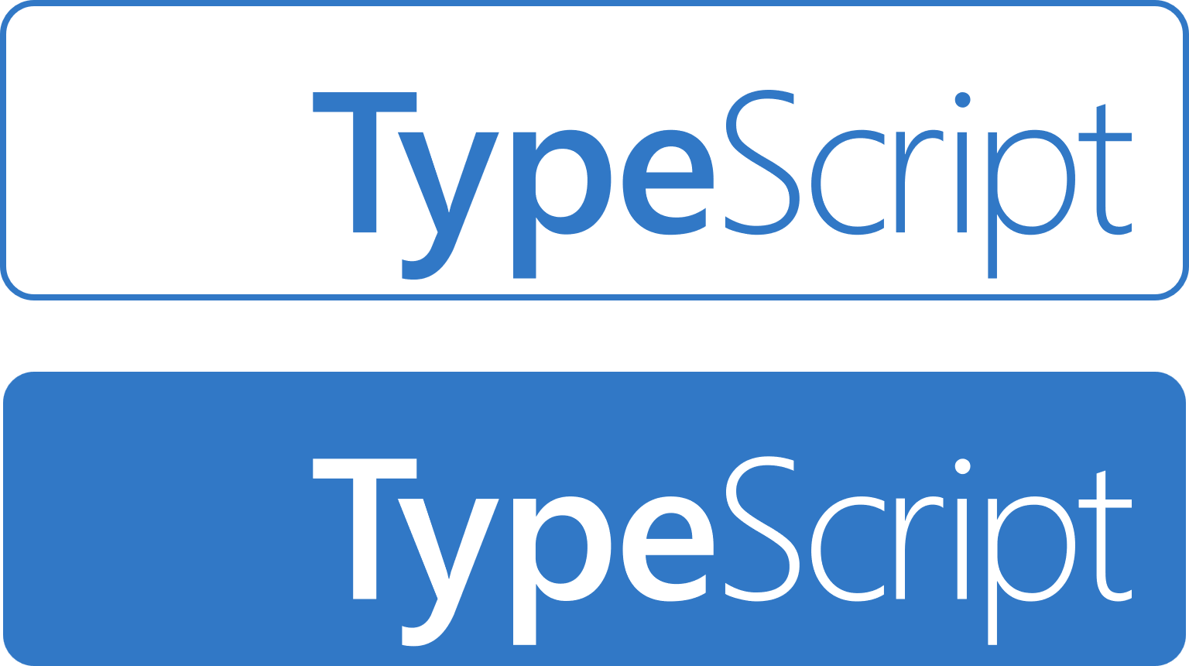
Levels - 2 Or Intermediate (UI Skills)

Slide 5

Levels - 3 (Backend Skills)
Springboot

Slide 6
Join Me In This Learning Journey

